Slide 1
Methods 1 Lab
Lecture 10

Slide 2
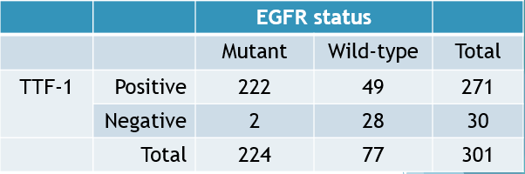
2x2 Tables in SPSS
2x2 tables are useful for calculating:
Conditional Probabilities
e.g. PPV, NPV, Bayes Rule
Relative Risk
Odds Ratios
Example 2x2 table
The lung cancer and EGFR mutation example

Slide 3
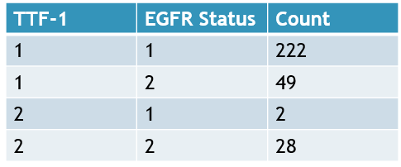
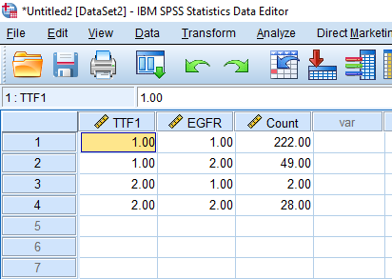
2x2 Table in SPSS - Exercise
Find the relative risk of EGFR mutant given TTF-1 being positive
Open a new data window
File -> New -> Data
Enter lung cancer and EGFR mutation example into SPSS

Slide 4
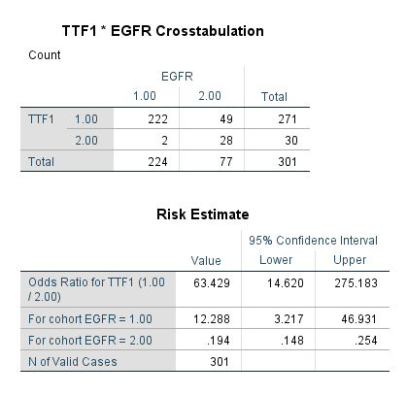
2x2 Tables in SPSS - Exercise
First, we must select which of the 3 variables in SPSS contains the counts
Data
Weight Cases
Select ‘Weight Cases By’
Select count variable
Second, we can Compute the 2x2 and calculate the relative risk or odds ratio.
Analyze
Descriptive Statistics
Crosstabs
Select TTF1 as the ‘Row(s)’
Select EGFR as the ‘Column(s)’
Click on ‘Statistics’
Select ‘Risk’
Continue
Ok

Slide 5

Pearson’s $χ^{2}$and Fisher’s Exact
Pearson’s Chi-Square Test
“Requires” expected cell counts to be at least 5
Fisher’s Exact Test
The expected cell counts can be small (less than 5)
In SPSS, the Pearson’s Chi-Square and Fisher’s Exact Tests are computed almost exactly the same as computing relative risks and odds ratios

Slide 6
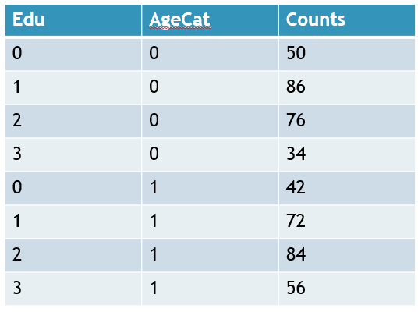
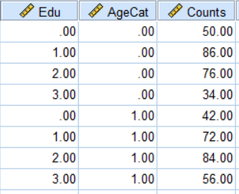

Pearson’s $χ^{2}$and Fisher’s Exact - Exercise
Please enter the following data into SPSS

Slide 7
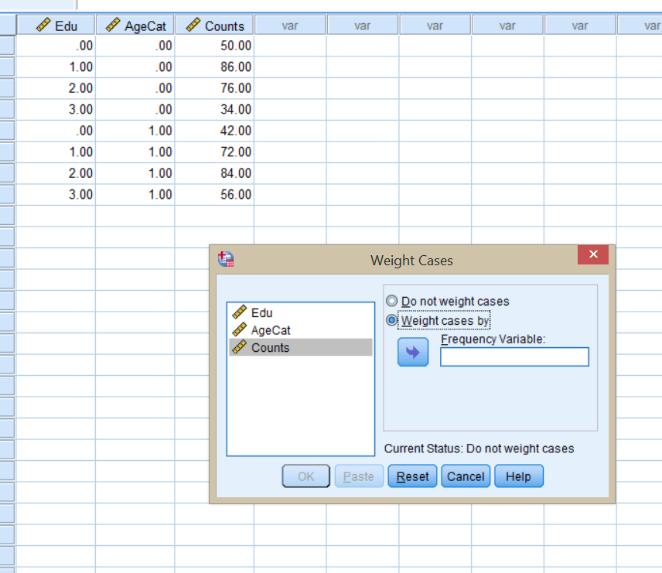
Pearson’s $χ^{2}$and Fisher’s Exact - Exercise
Prepare to do an analysis by identifying ‘Counts’ as a weight variable
Data
Weight Cases…
Weight cases by : Counts

Slide 8
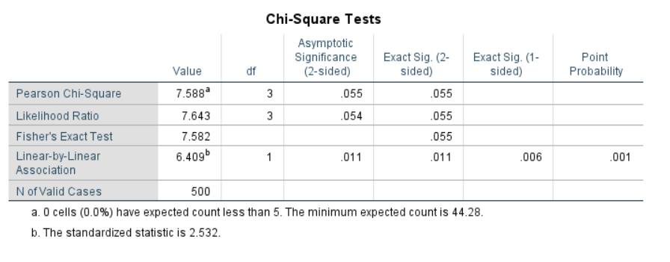

Pearson’s $χ^{2}$and Fisher’s Exact - Exercise
Perform a $χ^{2}$ test and a $χ^{2}$ trend test
Analyze
Descriptive Statistics
Crosstabs…
Row(s) : AgeCat
Column(s): Edu
Statistics…
Chi-square = check
For a Fisher’s exact, select ‘Exact…’ button and choose ‘Exact’

Slide 9
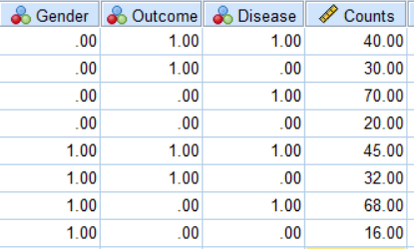
CMH Odds Ratios
Enter this data in SPSS:
Gender – > 1 = Female, 0 = Male
Outcome-> 1 = Heart Attack, 0 = No Heart Attack
Disease -> 1 = Diabetes, 0 = No Diabetes
Weight the Data by the counts

Slide 10
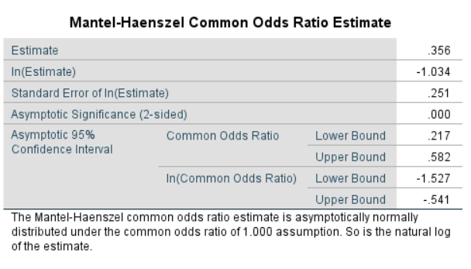
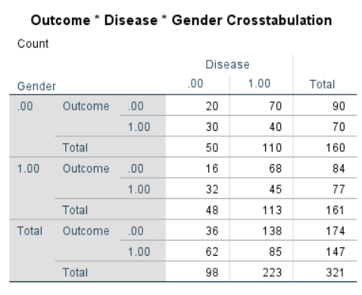
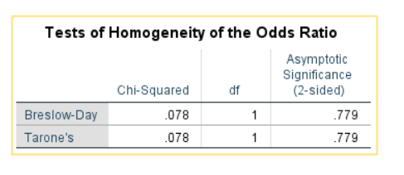
CMH Odds Ratios
Analyze
Descriptive Statistics
Crosstabs…
Row(s) : Outcome
Column(s): Disease
Layer 1 of 1: Gender
Statistics…
Cochran’s and Mantel-Haenzel Statistics = check
Risk = Check
Continue & Ok

Slide 11
McNemar’s Test
McNemar’s test is used for paired data
Hypotheses:
H0: OR = 1
H1: OR ≠ 1
Test Statistic:

Slide 12
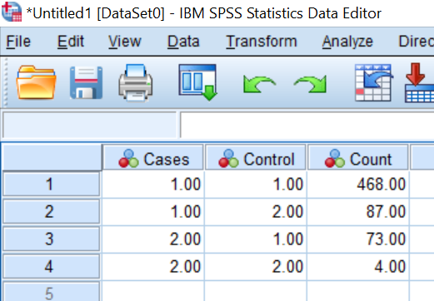
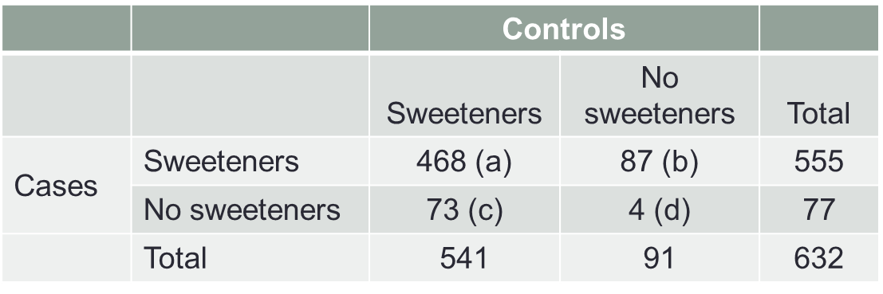
McNemar’s Test - Exercise
Matched case control study
Use McNemar’s test to determine if there is an association between sweeteners and bladder cancer.
Enter data into SPSS

Slide 13
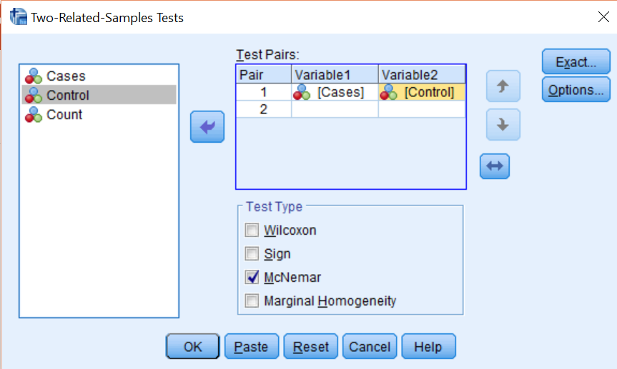
McNemar’s Test - Exercise
First, we must select which of the 3 variables in SPSS contains the counts
Data
Weight Cases
Select ‘Weight Cases By’ & Select count variable
Second, we can conduct McNemar’s test
Analyze
Nonparametrics
Legacy Dialogs
‘2 Related Samples’
Select cases and control variables as Variable1 and Variable2
Select ‘McNemar’ & Select OK

Slide 14
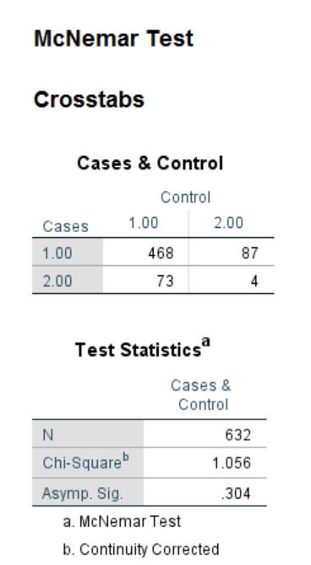
McNemar’s Test - Exercise
Is there an association
between sweeteners and
bladder cancer?

